Slide 1

Environmental pollution: Air
Information Security Fundamentals | Environmental Pollution and Remediation
Course: Information Security Fundamentals | Chapter: Environmental Pollution and Remediation | Program: Bachelor of Engineering
DISCOVER · LEARN · EMPOWER
Notes:
Welcome everyone to today's lecture on Air Pollution. We are focusing on the critical intersection of human activity and environmental degradation. As engineers, understanding these dynamics is essential for our future remediation strategies. Let us begin by exploring the specific mechanisms of air contamination.

Slide 2
Course Outcomes
SLIDE 2 / 14
Course Outcome
CO | BT LEVEL | DESCRIPTION
CO1 | BT4 | Recall, analyze and respond on fundamental environmental principles, such as ecological relationships and conservation strategies
CO2 | BT4 | Understand and analyze the interconnections between human activities and environmental impacts across different ecosystems
CO3 | BT4 | Understand and analyze and apply environmental laws and policies to analyse and propose solutions for real-world environmental challenges.
CO4 | BT2 | Students will analyse data from environmental monitoring programs to assess trends and predict future impacts on ecosystems.
CO5 | BT6 | Interpret, elaborate and propose various tools, design and innovative strategies for sustainable development and environmental conservation initiatives in securing the planet.
Chandigarh University
2 / 14
Notes:
Today's session directly addresses Course Outcome 2. We will analyze how specific industrial and vehicular activities directly impact our atmospheric ecosystems. This analysis is crucial for understanding the root causes of pollution before we can design effective remediation solutions.

Slide 3
Learning Objectives
SLIDE 3 / 14
Learning Outcomes
1
Analyze the primary sources and classification of air pollutants.
2
Evaluate the health and environmental impacts of major pollutants.
3
Calculate the concentration of pollutants using standard measurement units.
4
Assess the effectiveness of various air pollution control methods.
5
Apply remediation strategies to mitigate specific air quality issues.
Chandigarh University
3 / 14
Notes:
By the end of this lecture, you will be able to analyze the sources of air pollution and evaluate their specific impacts. We will move beyond definitions to calculate concentrations and assess control methods. These skills are vital for your engineering practice in environmental remediation.

Slide 4
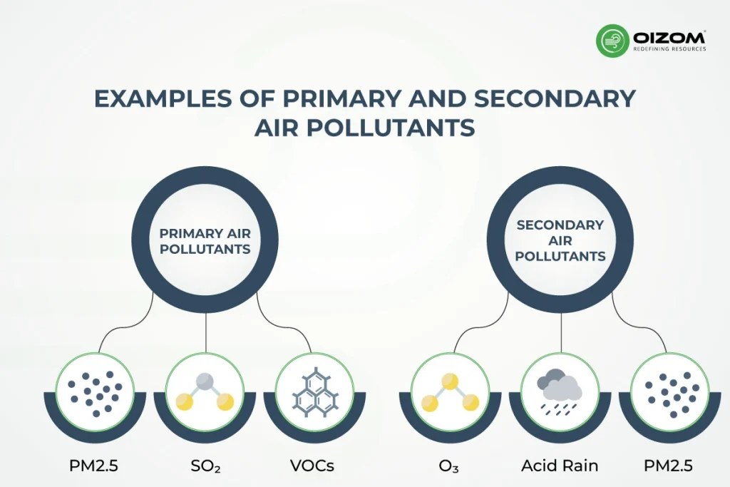
Lecture
SLIDE 4 / 14
Classification of Air Pollutants
1
Primary pollutants are emitted directly from identifiable sources like vehicles.
2
Secondary pollutants form in the atmosphere through chemical reactions.
3
Particulate matter includes solid particles and liquid droplets suspended in air.
4
Gaseous pollutants include sulfur dioxide, nitrogen oxides, and carbon monoxide.
5
Greenhouse gases trap heat and contribute to global warming trends.
Primary and Secondary Air Pollutants: What Sets Them Apart? - Oizom
Chandigarh University
4 / 14
Notes:
We classify pollutants into primary and secondary categories based on their origin. Primary pollutants like sulfur dioxide are emitted directly, while secondary pollutants like ozone form later. Understanding this distinction is key because control strategies differ significantly for each type.

Slide 5
Lecture
SLIDE 5 / 14
Major Gaseous Pollutants
1
Sulfur dioxide causes acid rain and respiratory issues in humans.
2
Nitrogen oxides contribute to smog formation and acid deposition.
3
Carbon monoxide reduces oxygen transport in human blood significantly.
4
Ozone at ground level damages crops and irritates lung tissues.
5
Volatile organic compounds react with sunlight to form ground-level ozone.
Chandigarh University
5 / 14
Notes:
Sulfur dioxide and nitrogen oxides are the primary drivers of acid rain and smog. Carbon monoxide is particularly dangerous because it binds to hemoglobin more strongly than oxygen. These gases often originate from incomplete combustion in industrial and vehicular engines.

Slide 6
Lecture
SLIDE 6 / 14
Particulate Matter and Health
1
PM10 particles are large enough to be trapped in the upper airways.
2
PM2.5 particles penetrate deep into the lungs and enter the bloodstream.
3
Black carbon absorbs sunlight and accelerates glacial melting in polar regions.
4
Long-term exposure increases risks of cardiovascular and respiratory diseases.
5
Filtration systems are essential for removing fine particulates from exhaust.
Chandigarh University
6 / 14
Notes:
The size of particulate matter determines its health impact significantly. PM2.5 is particularly dangerous because it bypasses natural lung defenses and enters the bloodstream. This leads to systemic inflammation and increased risks of heart disease and stroke.

Slide 7
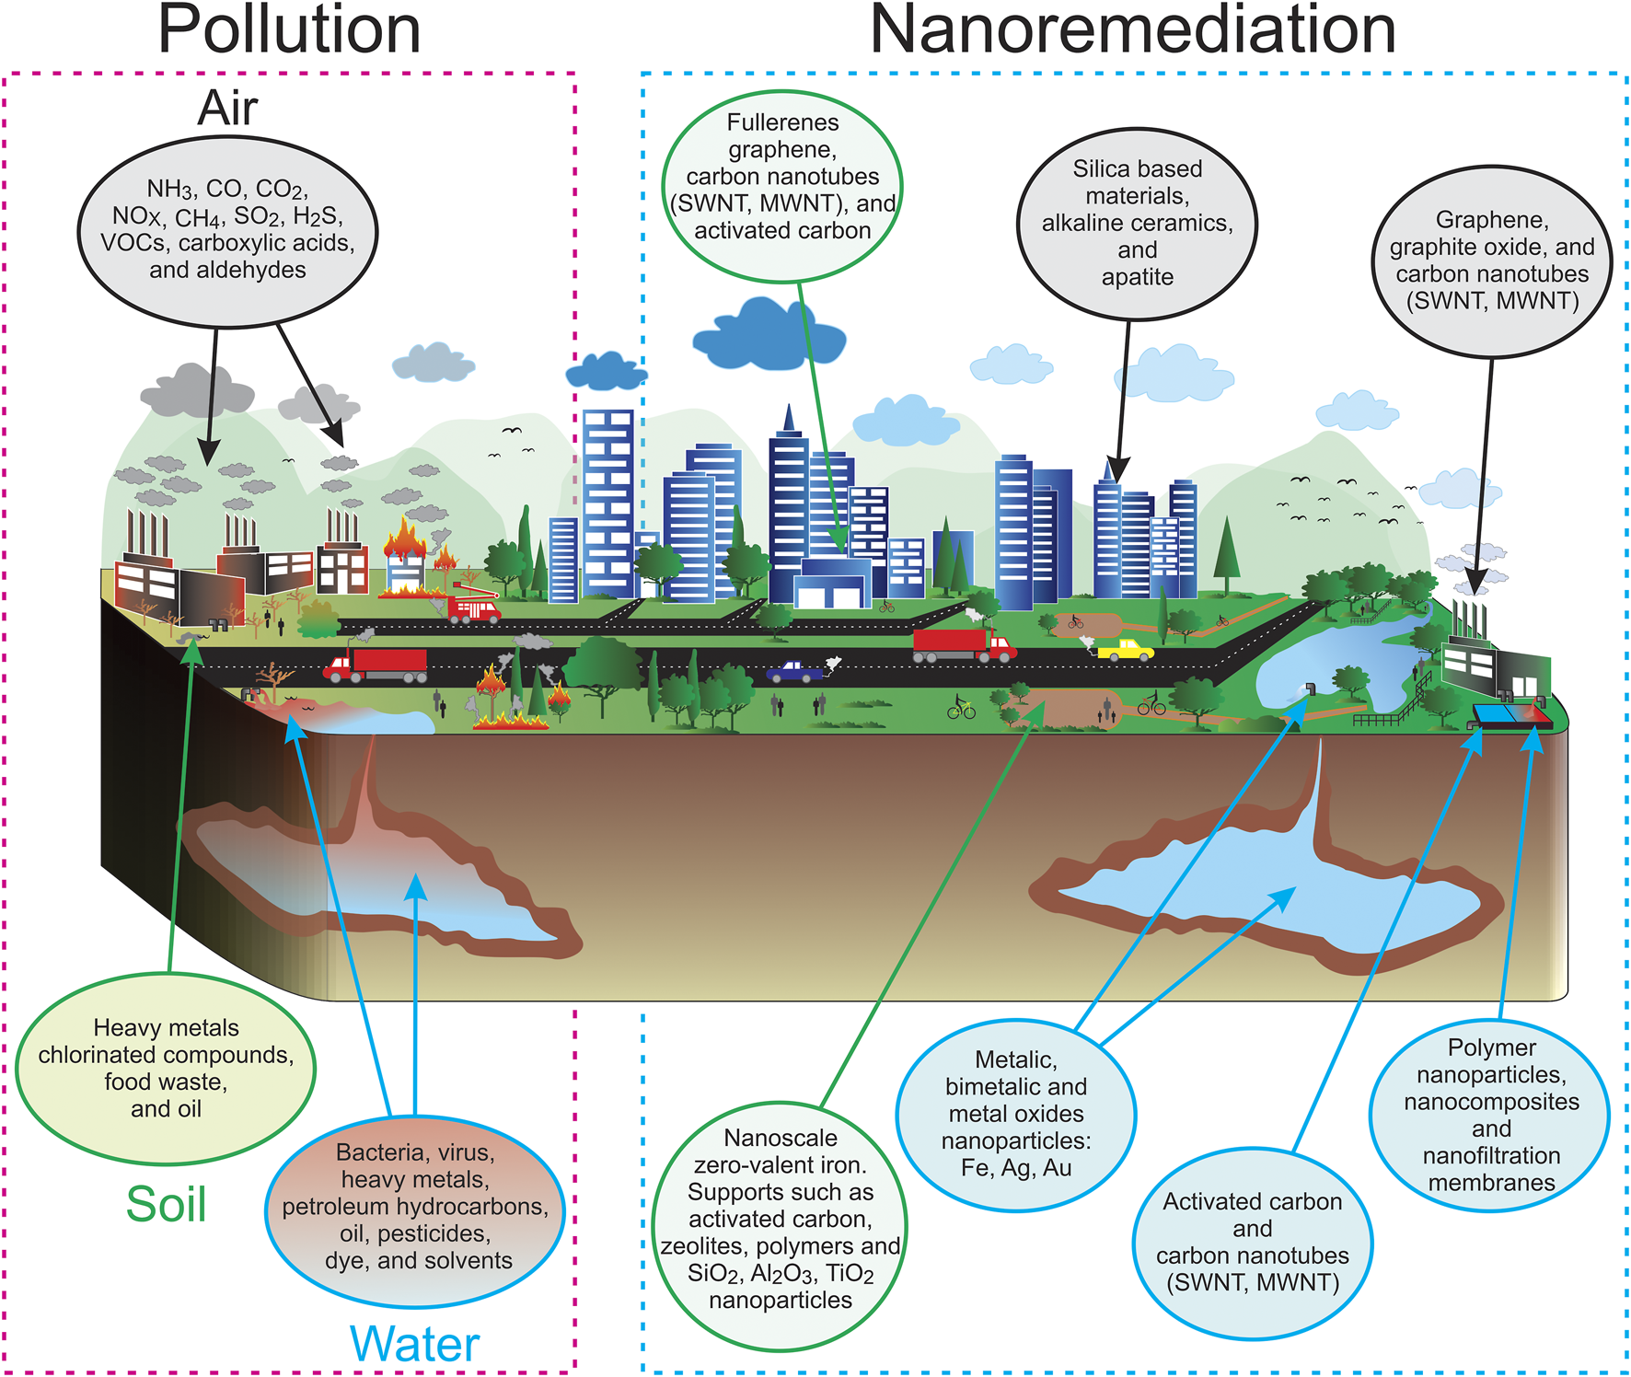
Lecture
SLIDE 7 / 14
Atmospheric Stability and Dispersion
1
Temperature inversions trap pollutants near the ground preventing dispersion.
2
Stable atmospheric conditions lead to high concentrations of local pollutants.
3
Unstable conditions promote vertical mixing and dilution of contaminants.
4
Wind speed and direction determine the transport path of pollutants.
5
Topography like valleys can channel pollutants and worsen local air quality.
Frontiers | Nanoremediation: Nanomaterials and Nanotechnologies for Environmental Cleanup (source: www.frontiersin.org)
Chandigarh University
7 / 14
Notes:
Atmospheric stability dictates how pollutants disperse in the environment. During a temperature inversion, a layer of warm air traps cold air and pollutants near the ground. This phenomenon often leads to severe smog events in urban valleys.

Slide 8
Lecture
SLIDE 8 / 14
Acid Rain Formation Mechanism
1
Sulfur dioxide reacts with water vapor to form sulfuric acid.
2
Nitrogen oxides react to form nitric acid in the atmosphere.
3
Acid rain lowers the pH of soil and aquatic ecosystems significantly.
4
Corrosion of buildings and monuments is a visible economic impact.
5
Remediation involves reducing precursor emissions at the source.
Chandigarh University
8 / 14
Notes:
Acid rain forms when sulfur dioxide and nitrogen oxides react with atmospheric water. The resulting acids lower the pH of lakes and soils, harming aquatic life. This process also accelerates the corrosion of stone monuments and metal structures.

Slide 9
Lecture
SLIDE 9 / 14
Greenhouse Effect and Climate
1
Greenhouse gases trap infrared radiation and warm the lower atmosphere.
2
Carbon dioxide is the primary long-lived greenhouse gas from human activity.
3
Methane has a higher warming potential but shorter atmospheric lifetime.
4
Global warming leads to rising sea levels and extreme weather events.
5
Mitigation requires transitioning to renewable energy and carbon capture.
Frontiers | Nanoremediation: Nanomaterials and Nanotechnologies for Environmental Cleanup (source: www.frontiersin.org)
Chandigarh University
9 / 14
Notes:
The greenhouse effect is a natural process amplified by human emissions of carbon dioxide. Methane is more potent per molecule but exists for a shorter time than CO2. Addressing this requires a global shift towards renewable energy sources and carbon capture technologies.

Slide 10

Worked Example
SLIDE 10 / 14
Concentration Calculation
GOVERNING EQUATION
Formula: C = m_pollutant / V_air × 10^6 for ppm
EXAMPLE
5 mg of SO2 in 2 m³ of air.
CALCULATION
5 mg / 2000 L = 2.5 mg/L.
RESULT
2.5 ppm assuming standard density for air conversion.
• Concentration (C) equals mass of pollutant divided by volume of air.
Source: www.conceptdraw.com
Chandigarh University
10 / 14
Notes:
Let us calculate the concentration of sulfur dioxide in a specific air sample. If we have 5 milligrams of SO2 in 2 cubic meters of air, we convert the volume to liters. Dividing the mass by the volume gives us the concentration in milligrams per liter, which converts to ppm.

Slide 11

Lecture
SLIDE 11 / 14
Common Pitfalls in Analysis
1
Confusing mass concentration with volume concentration leads to errors.
2
Ignoring temperature and pressure effects on gas volume measurements.
3
Overlooking secondary pollutant formation in short-term studies.
4
Assuming uniform dispersion without considering local wind patterns.
5
Neglecting the cumulative effect of multiple pollutant sources.
Source: lh5.googleusercontent.com
Chandigarh University
11 / 14
Notes:
A common mistake is confusing mass concentration with volume concentration without proper conversion. Students often ignore how temperature and pressure affect gas volume measurements. Additionally, failing to account for secondary pollutant formation can lead to underestimating total pollution levels.

Slide 12
Remediation
SLIDE 12 / 14
Scrubbers and Filters
1
Wet scrubbers remove particulates and soluble gases using liquid sprays.
2
Electrostatic precipitators charge particles to collect them on plates.
3
Catalytic converters reduce nitrogen oxides and carbon monoxide in vehicles.
4
Bag filters capture fine particulates from industrial exhaust streams.
5
Activated carbon adsorbs volatile organic compounds effectively.
Chandigarh University
12 / 14
Notes:
Remediation technologies like wet scrubbers use liquid sprays to capture both particulates and soluble gases. Electrostatic precipitators are highly effective for fine dust in industrial stacks. Catalytic converters in vehicles are essential for reducing harmful exhaust emissions before release.

Slide 13
Lecture
SLIDE 13 / 14
Key Takeaways
1
Air pollution involves complex interactions between primary and secondary pollutants.
2
Particulate matter size determines the depth of human health impacts.
3
Atmospheric stability controls the dispersion and accumulation of contaminants.
4
Acid rain and greenhouse effects are major global environmental challenges.
5
Effective remediation requires source control and advanced filtration technologies.
Chandigarh University
13 / 14
Notes:
To summarize, air pollution is a complex issue involving both primary and secondary pollutants. The size of particulate matter is critical for understanding health risks. Effective remediation requires a combination of source control and advanced filtration technologies.

Slide 14
Lecture
SLIDE 14 / 14
References
ENVIRONMENTAL STUDIES
From Crisis to Cure — R. Rajagopalan
• Environmental Science and Engineering — Benny Joseph
• Environmental Studies — R.C. Sharma and D. Gurbir Sangha
• Introduction to Environmental Science — Anjaneyulu, Y.
• Environmental Pollution Control Engineering — C.S. Rao
• Textbook of Environmental Studies for undergraduate courses — E. Bharucha
• Environmental Science — S.C. Santra
Chandigarh University
14 / 14
Notes:
These references provide comprehensive coverage of environmental science and pollution control. I encourage you to consult these texts for deeper insights into remediation engineering. They are essential resources for your ongoing studies and future professional practice.

